Slide 1
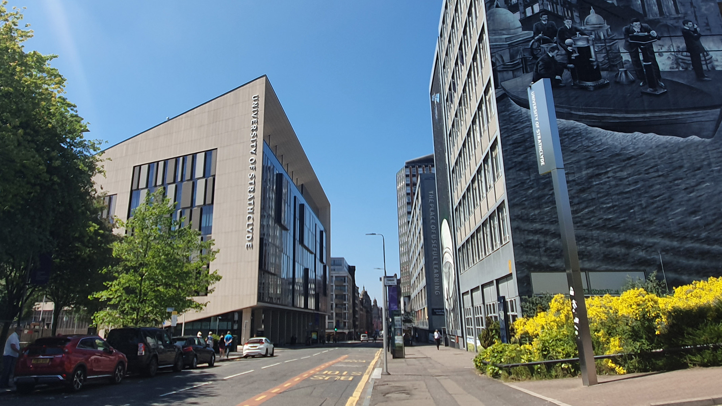

Digital filters
Digital Filters Design: FIR design methods
carmine.clemente@strath.ac.uk

Slide 2
Introduction
The design of FIR filters is generally easier than IIR filters;
Also in this case we will introduce 2 methods: Window and Optimal design.
We will also see how we can use Matlab to design a wide range of FIR filters.

Slide 3
Introduction
The design of FIR filters is generally easier than IIR filters;
Also in this case we will introduce 2 methods: Window and Optimal design.
We will also see how we can use Matlab to design a wide range of FIR filters.

Slide 4
Windows
Windowing using window functions are used to reduce the effects of Scallop Loss and Spectral Leakage.
First let us define 5 popular windows of length N.
Each window has its own characteristics in terms of Side-lobe levels and main-lobe size.
Rectangular
Hanning
Hamming
Blackman
Kaiser
I₀ is the zeroth-order modified Bessel function of the first kind

Slide 5
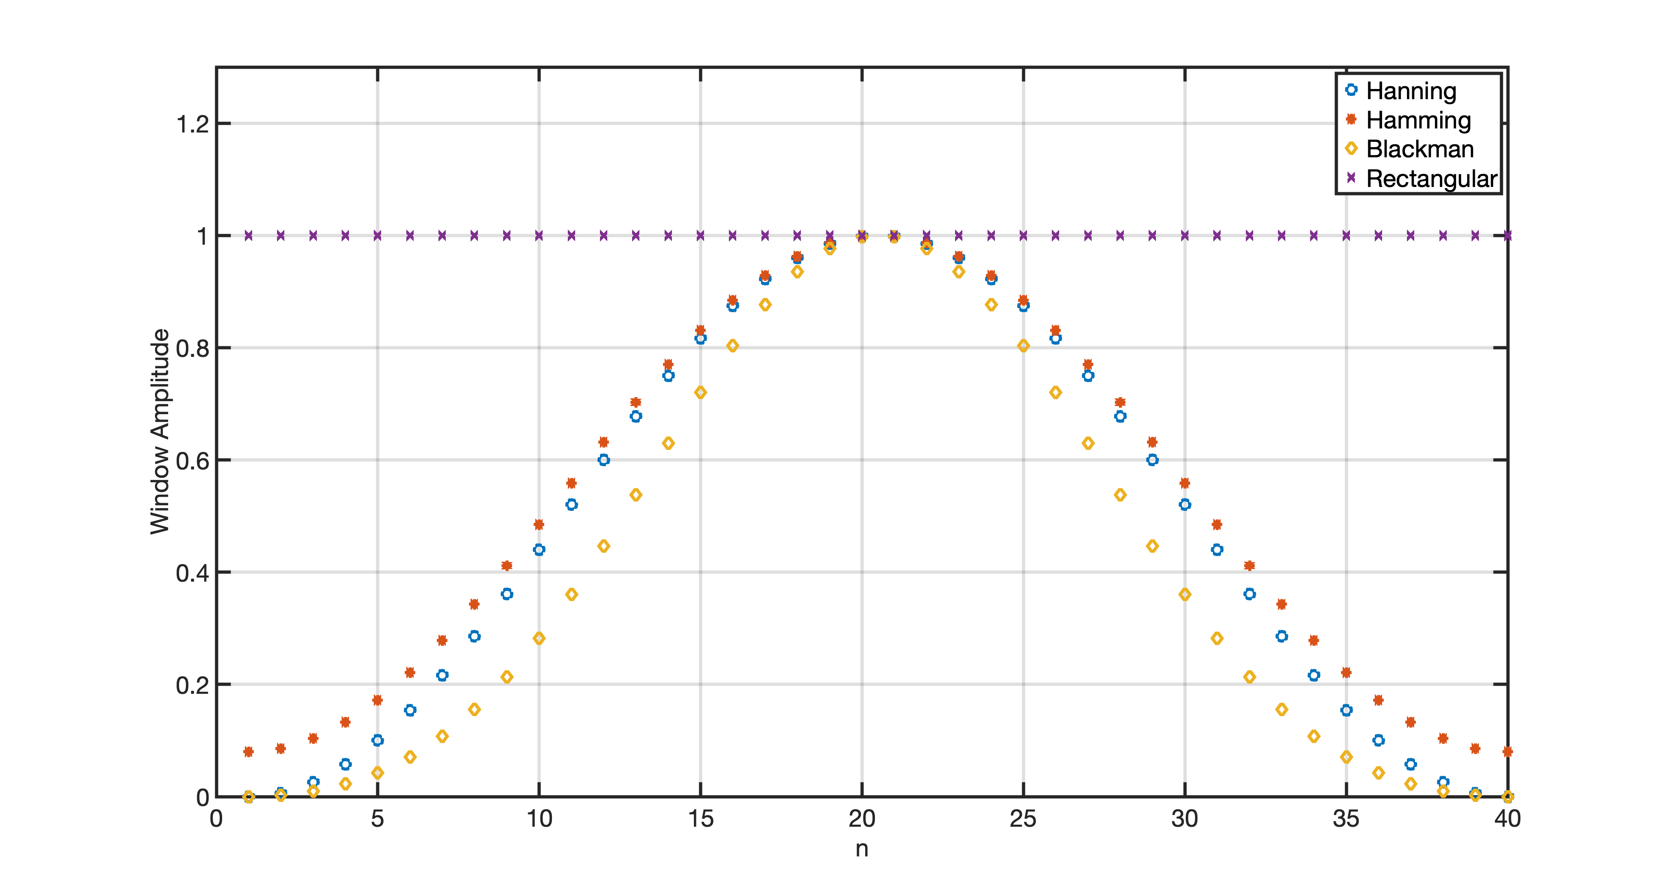
Windows
Time plot – N=40

Slide 6
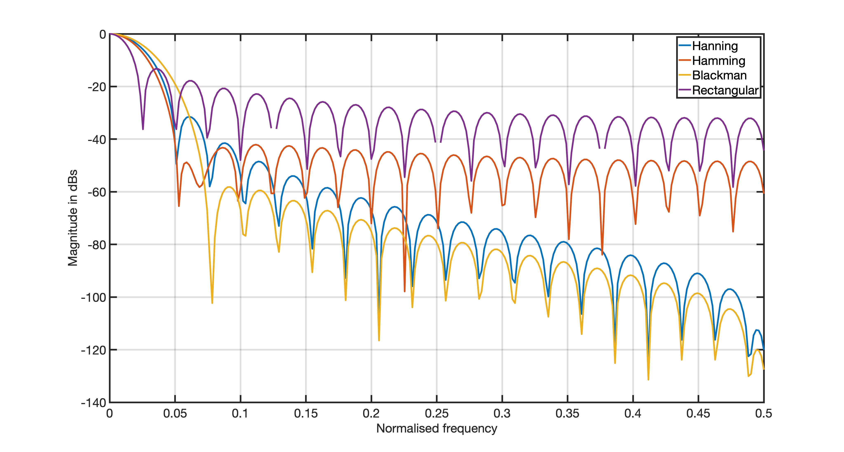
Windows- Spectra
Lower side lobes mitigate spectral leakage… but the main lobe broadens!

Slide 7
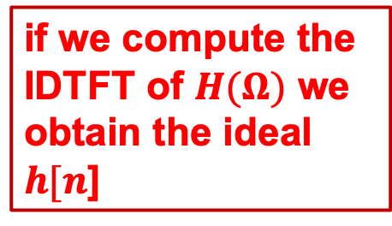
FIR design using windows
Ideal Specifications of Digital LP Filter with cutoff freqs$Ωc=±π/2;$
$$|H(Ω)|$$
if we compute the IDTFT of $H(Ω)$ we obtain the ideal $h[n$]

Slide 8
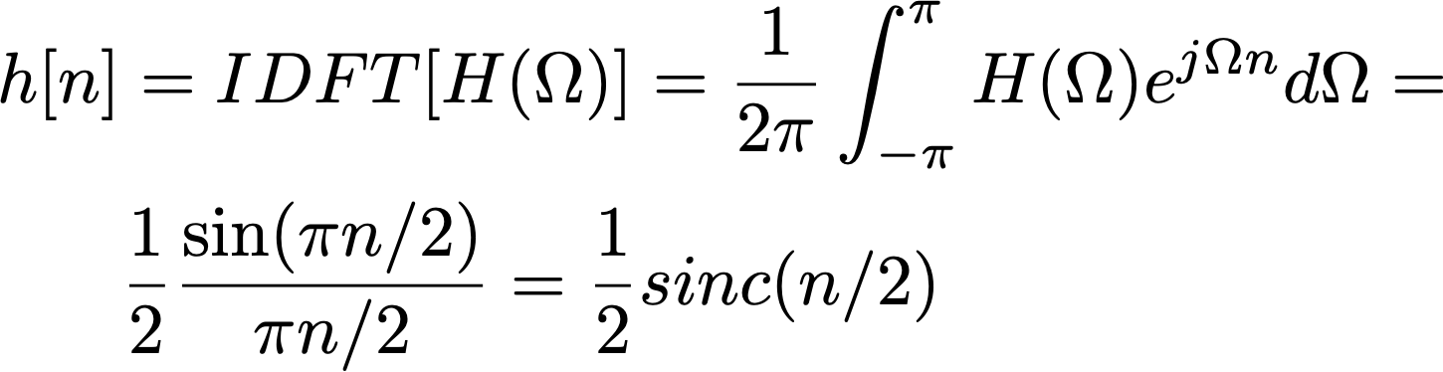
Impulse response of Ideal LP digital Filter
Impulse response of ideal LP filter
h[n] is infinite! we need to truncate it to make it finite

Slide 9
Example
Design a causal, FIR LPF with 41 taps (coefficients) with Linear Phase (Symmetric Impulse Response)

Slide 10
Example
Truncation:
Extract 41 non zero coefficients using a rectangular Window of length 41
w[n] = 1 for -20 < n < 20
= 0 otherwise
i.e. Truncate the infinite duration IR to a Finite Impulse Response (FIR) using a rectangular window

Slide 11
Example
Truncation:
Now we need to make it causal and we need to mitigate the edge effects due to the truncation

Slide 12
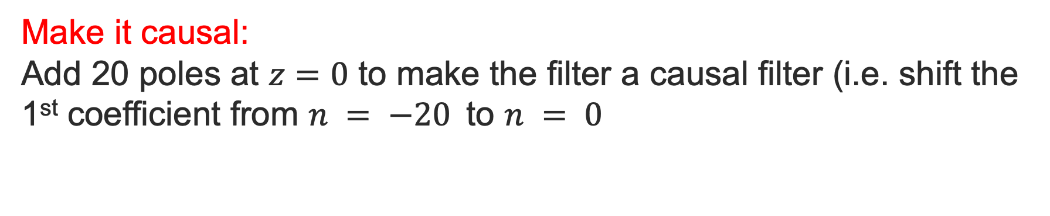

Example
Make it causal:
Add 20 poles at $z=0$ to make the filter a causal filter (i.e. shift the 1st coefficient from $n = −20$to $n = 0$
starts for $n=0$, so it is causal!

Slide 13
Example
Reduce windowing issues (Spectral Leakage): apply another window (e.g. Hamming)
x

Slide 14
Example
41 taps impulse response

Slide 15
Example
41 taps impulse response

Slide 16
Example
41 taps impulse response
$−π 0 π$

Slide 17
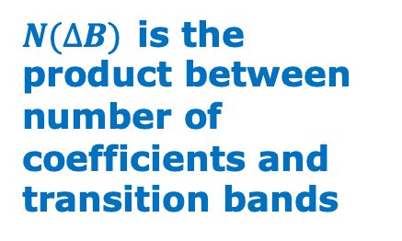
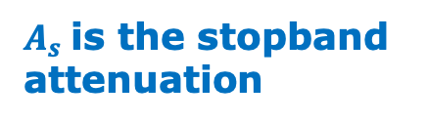
Characteristics of Window based FIR Filters
Window | N(∆B) Hz | A_{s} dBs | Sidel Lobe dBs | SL dBs
Rectangular | 0.9 | -21 | -13 | 3.92
Hanning | 3.1 | -44 | -31 | 1.42
Hamming | 3.3 | -53 | -41 | 1.78
Blackman | 5.5 | -74 | -57 | 1.10
Kaiser b=2 | 1.5 | -29 | -19 | 1.46
b=4 | 2.6 | -45 | -30
b=6 | 3.8 | -63 | -44
b=10 | 5.1 | -81 | -59
b=12 | 6.4 | -99 | -74
$N(∆B)$is the product between number of coefficients and transition bands
$A_{s}$is the stopband attenuation

Slide 18
Optimal FIR Filters design
Design a lowpass filter with a passband-edge frequency of 1500Hz, a stopband-edge of 2000Hz, passband ripple of 0.01, stopband ripple of 0.1, and a sampling frequency of 8000Hz.
Use the Parks-McClellan Optimal method.
With this method we can control the ripple levels (not possible with the windows based approach).

Slide 19
Parks-McClellan in Matlab
Exercise: using help and doc in Matlab understand how these lines of code operate.
[n,fo,mo,w] = firpmord( [1500 2000], [1 0], [0.01 0.1], 8000 );
n = 21
fo = [0 0.375 0.5 1.0]
mo = [1 1 0 0]
w = [ 10 1]
b = firpm(n,fo,mo,w); % this computes the 22 coefficients of the impulse response of the low pass filter.

Slide 20
Parks-McClellan in Matlab

Slide 21
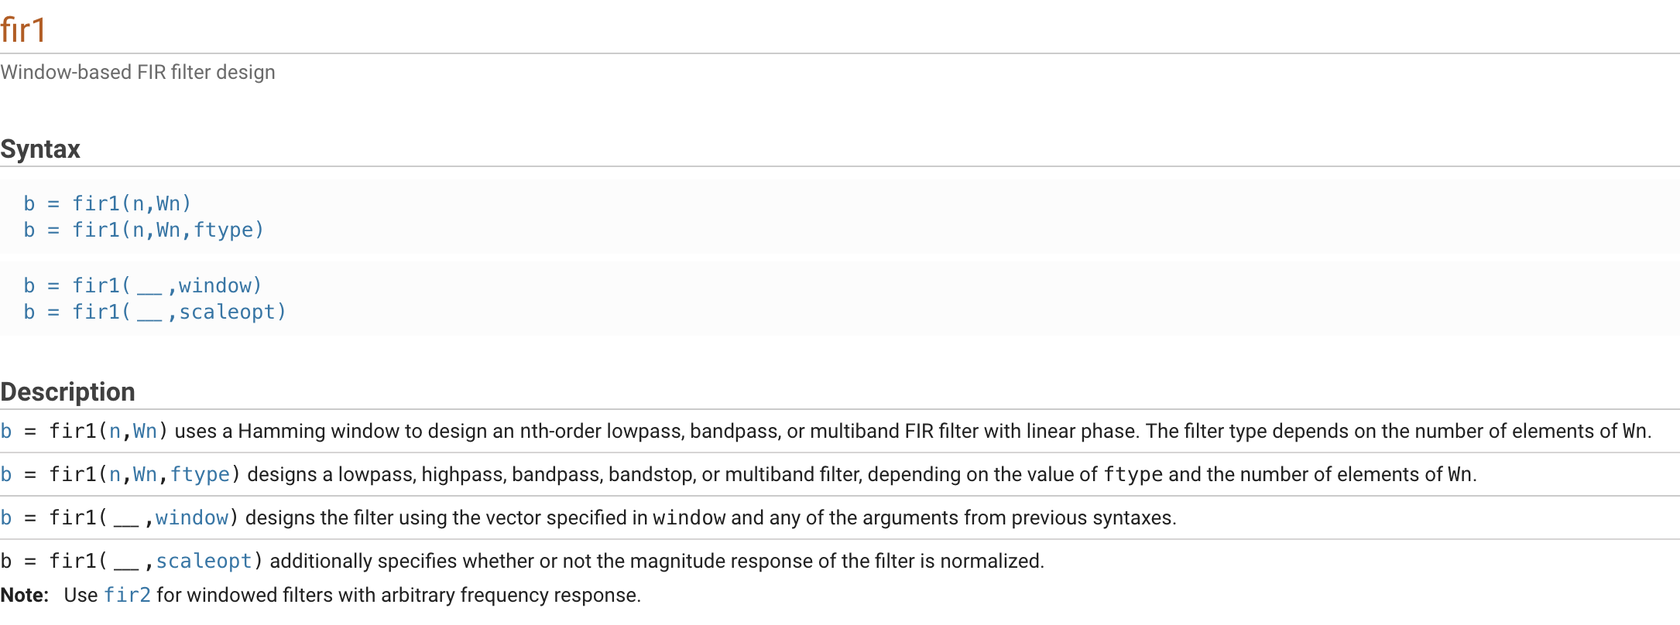
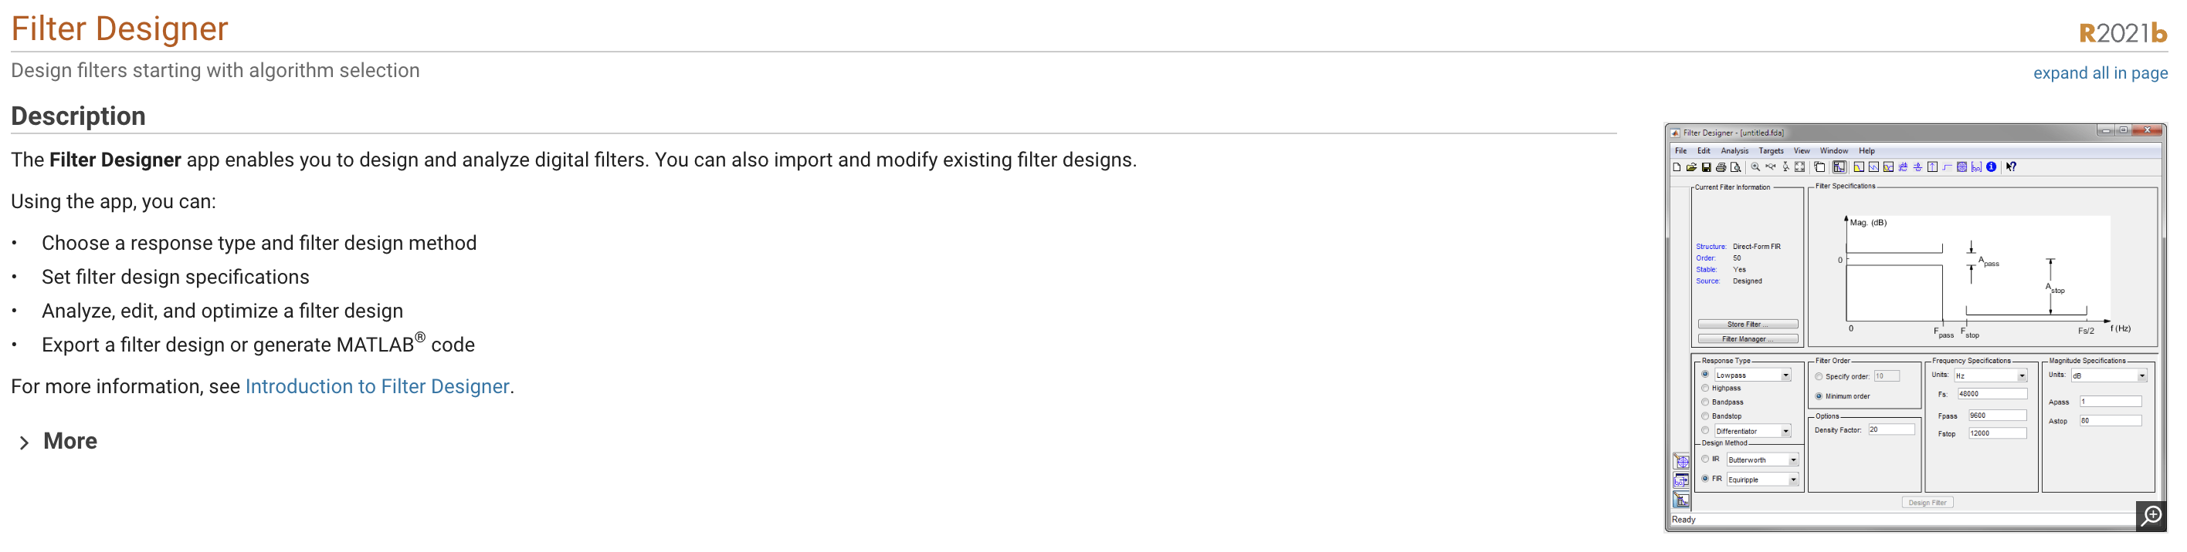
Other ways to design FIR filters In MATLAB
many fir* functions available

Slide 22
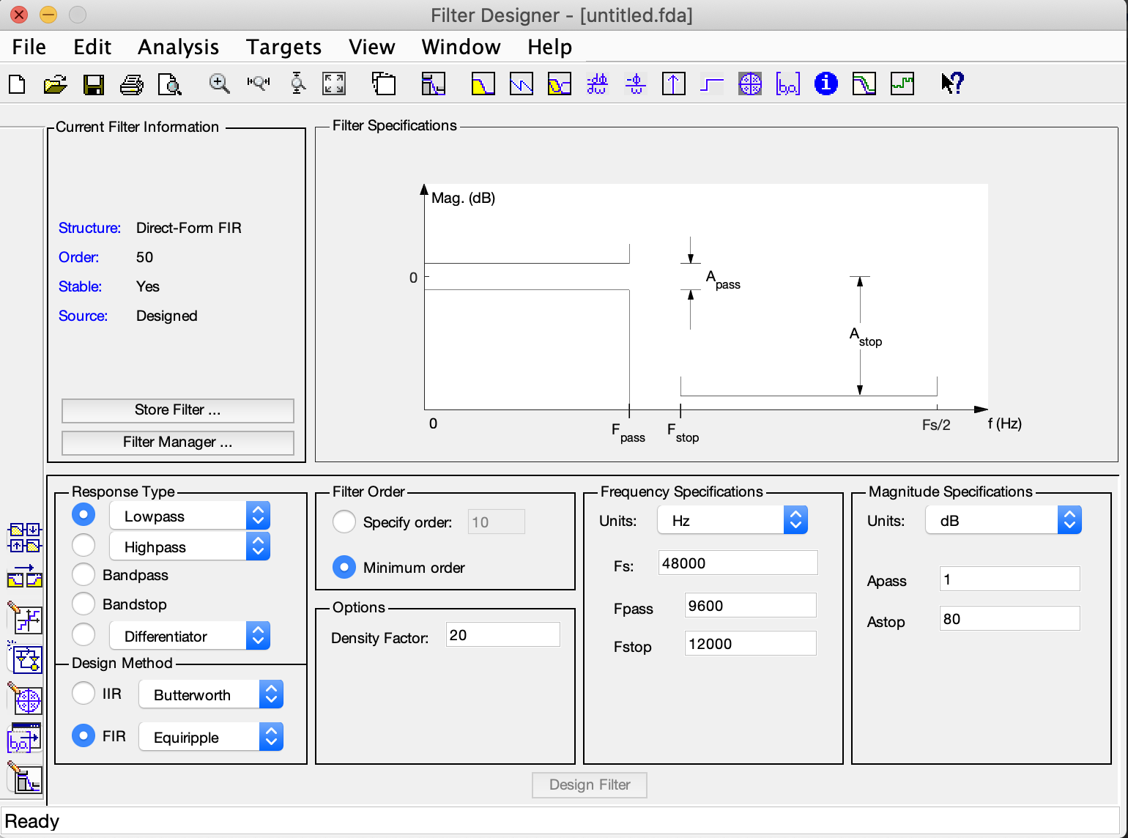
Filter Designer

